Slide 1

Real Time Semantic Segmentation using Detectron2
Yuxin Wu, Alexander Kirillov, Francisco Massa,
Wan-Yen Lo and Ross Girshick and many other contributors
Sai Kumar Dandla
IBM certified DS Professional | Google Certified Tensor flow Developer
https://github.com/facebookresearch/detectron2

Slide 2

A research platform and a production library for object detection,
mainly built by Facebook AI Research (FAIR)
https://github.com/facebookresearch/detectron2

Slide 3
What is Object Detection?
recognize, localize, and predict attributes of objects in images

Slide 4




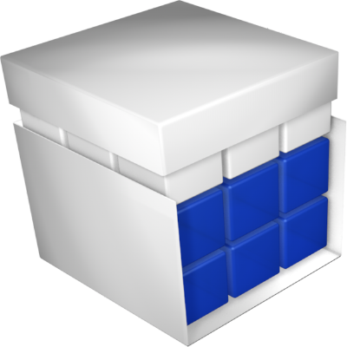



Family of Detection Codebase
official fast RCNN
02/2015
official faster RCNN
08/2015
py-faster-rcnn
^{06/2017} TF object detection API
11/2017 Matterport/Mask_RCNN
Tensorpack R-CNN
Detectron
01/2018
Detectron.pytorch
maskrcnn-benchmark
03/2018
09/2018
mmdetection
10/2018
01/2019
SimpleDet
10/2019

Slide 5


Modular
FASTER
PYTORCH
Accurate

Slide 6

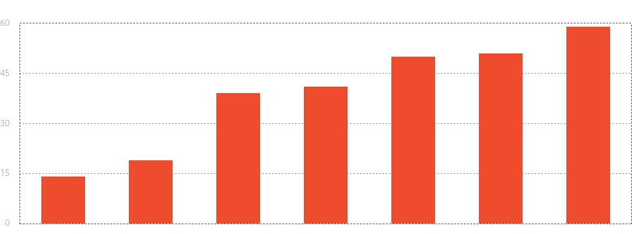

What’s in Detectron2: training speed
Training Throughput of R50-FPN Mask R-CNN
(img/s)
Detectron
mmdetection
maskrcnn-benchmark
matterport
SimpleDet Tensorpack Detectron2
Details at: detectron2.readthedocs.io/notes/benchmarks.html

Slide 7
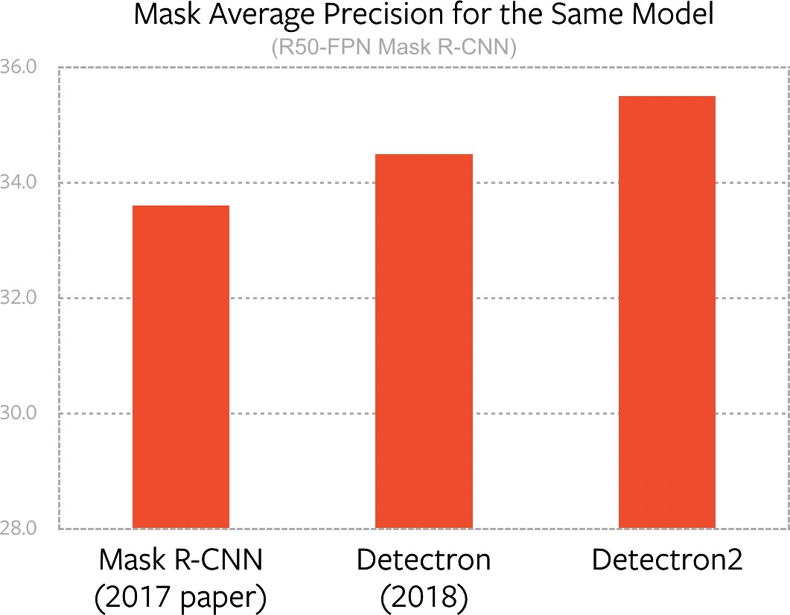
What’s in Detectron2: accuracy
Latest SOTA models included
Same model, more accurate
By fixing legacy issues
github.com/facebookresearch/detectron2/tree/master/configs/Detectron1-Comparisons

Slide 8
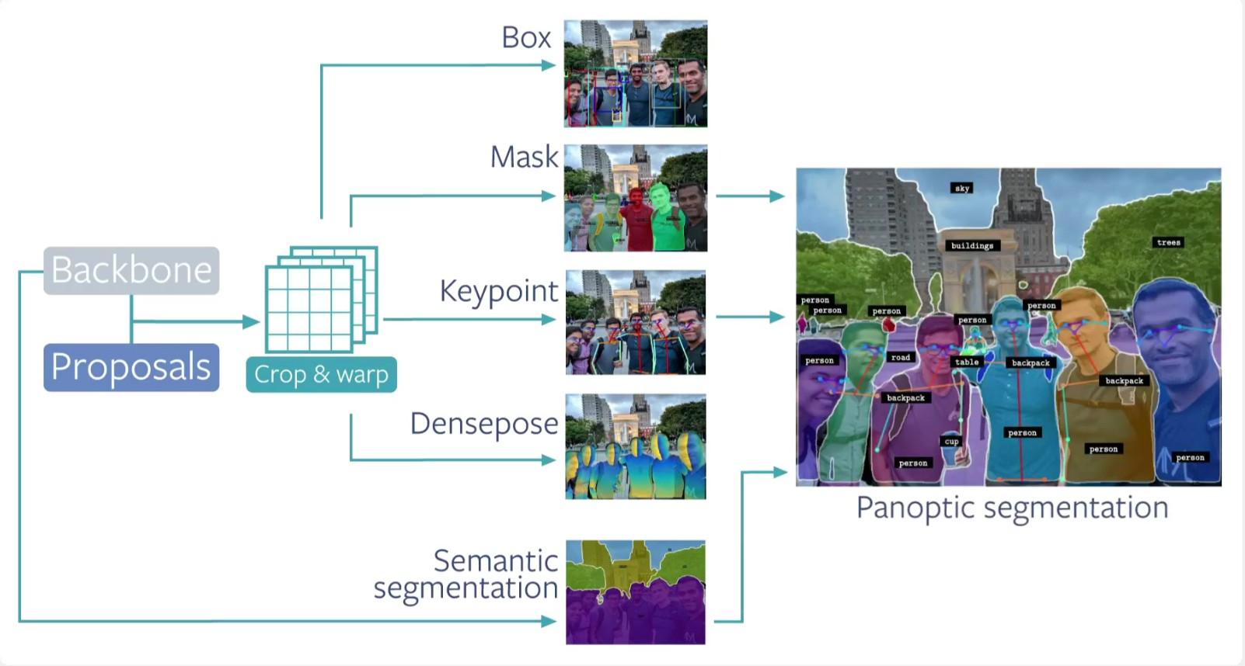
What’s in Detectron2: Generalized R-CNN Models(+ a few other types of models: RetinaNet, TensorMask, etc.)

Slide 9
What’s in Detectron2: data / tasks
Datasets:
COCO
LVIS
CityScapes
PascalVOC
Tasks (data & evaluation):
(Rotated) Box Detection
{Instance,Semantic,Panoptic} Segmentation
Person Keypoint, DensePose
• + Your own data / models / tasks

Slide 10
Extend Detectron2 for Research & Production
Hack inside the code:
vim detectron2
Quick & flexible prototyping
Not scalable / maintainable
Extend existing code:
Some* code duplication
Take some time
Maintainable
Good research codebase should be Hackable and Extensible
import detectron2

Slide 11
Extensible / Customizable
new backbone
@BACKBONE_REGISTRY.register() class MyBackbone(Backbone):
...
Allow users to plug in custom
Models
Datasets
Data loading routines
Augmentations
Tasks/Metrics
Training logic
…
without having to modify detectron2
new box head
@ROI_BOX_HEAD_REGISTRY.register() class MyBoxHead(nn.Module):
...
new type of head
@ROI_HEADS_REGISTRY.register() class MyHeads(StandardROIHeads):
...
new dataset
DatasetCatalog.register(...)
Docs: https://detectron2.readthedocs.io/tutorials/extend.html

Slide 12


Colab Tutorial: fine-tune on a new dataset in 5min
Train it in Colab!

Slide 13
Real Example: DensePose (detectron2/projects/DensePose)

Slide 14

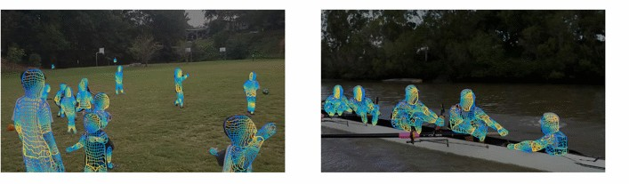
Real Example: DensePose (detectron2/projects/DensePose)
├── densepose
│ ├── init .py
│ ├── config.py
│ ├── dataset.py
│ ├── dataset_mapper.py
│ ├── densepose_coco_evaluation.py
│ ├── densepose_head.py
│ ├── evaluator.py
│ ├── roi_head.py
│ ├── structures.py
New heads
New configs
New dataset
New data loader
New evaluation
Its own training script
└── train_net.py

Slide 15
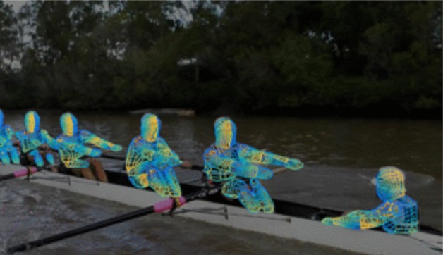
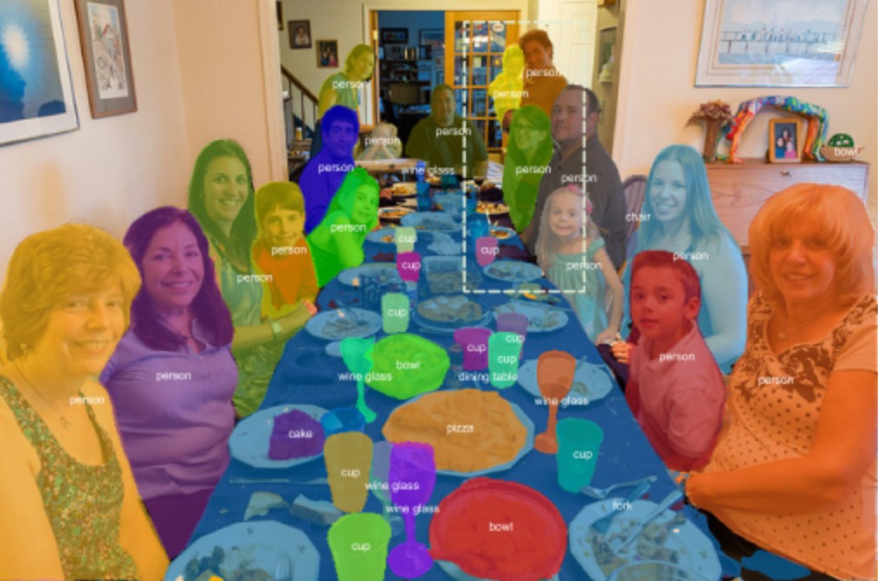

More Research Released by import detectron2
DensePose (CVPR18)
TensorMask (ICCV 19)
Mesh R-CNN (ICCV 19)
coming in a month

Slide 16
Extensibility allows us to
Maintain the projects separately
Share improvements of core detectron2
Easily collaborate with each other
Transfer latest research to products

Slide 17

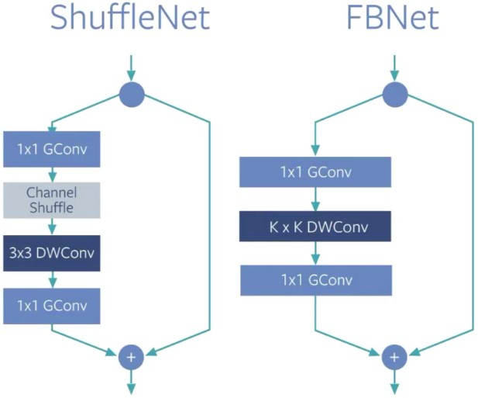
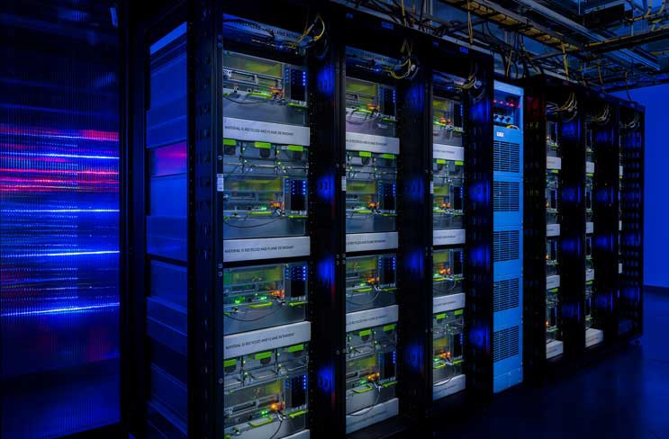
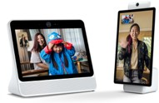
import detectron2 in Production
Domain-specific production data
Efficient, low-latency models (open source soon)
Large scale training on GPU clusters
Conversion & optimization for deployment on server/mobile/edge (open source soon)

Slide 18
Upcoming Production Features
R-CNN models based on efficiency-oriented architectures
(FBNet, ShuffleNet, MobileNet, etc)
Conversion, optimization & quantization with ONNX/Caffe2
Some run in <100ms on mobile/server CPUs

Slide 19
Side Note: Beware of Speed/Accuracy Comparisons
Comparisons across publications/codebases are often uncontrolled
Accuracy varies with hyper-parameters (‘recipe’)
Speed varies with software (perf tuning) and hardware
Speed varies with low-level optimization & model-specific optimization
Speed varies with inference details (e.g., batching, quantization)
Therefore, speed/acc. results should be taken with a large grain of salt
We’ll release what works the best for Facebook

Slide 20

https://github.com/facebookresearch/detectron2
Reference
Detectron2 paper’s and slides credit’s
Yuxin Wu, Alexander Kirillov, Francisco Massa, Wan-Yen Lo and Ross Girshick
Detectron2 is FAIR's next-generation platform for object detection and segmentation.
https://ai.facebook.com/tools/detectron2

